Slide 1
Flying Drones with Gestures
How to fly drones directly using gestures filmed by a camera

Slide 2







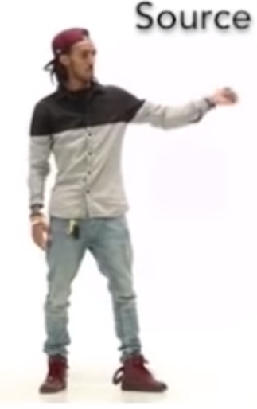







Pose Detection: How it Works
PoseNet
Gesture Detection
Steering Module
Video
Wireframe
Movements
Accounting
Accounting System
Azure SQL
Pricing Parameters
Reference Data
Contract Data
Payment
eBanking
Container Provider System
Insurer Contract Management System
Delivery of transport data:
Client
Start / end position
Temperature data
Storage of contract data for risk and capital management purposes
Storage of claims data for claims settlement
Transport Data
Contract Data
Document Storage
Legend:
Manual Interface
REST API
System
Database
Report
Component
Functionality
Flow
Logic Apps
Azure Functions

Slide 3

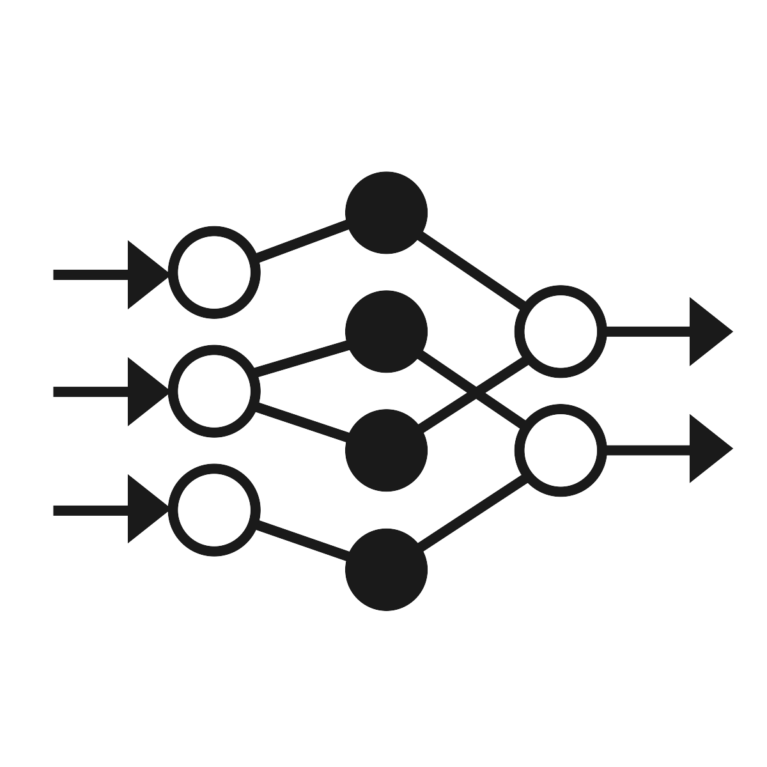

Pose Detection: How it Works
PoseNet
Gesture Detection
Steering Module
Client (Browser)
Video
Server
Server
Steering Module
Wireframe
Movements
Accounting
Accounting System
Azure SQL
Pricing Parameters
Reference Data
Contract Data
Payment
eBanking
Container Provider System
Insurer Contract Management System
Delivery of transport data:
Client
Start / end position
Temperature data
Storage of contract data for risk and capital management purposes
Storage of claims data for claims settlement
Transport Data
Contract Data
Document Storage
Legend:
Manual Interface
REST API
System
Database
Report
Component
Functionality
Flow
Logic Apps
Azure Functions

Slide 4

Postures Large
STOP
stop | 0
left | 1
right | 2
up | 3
down | 4
Images were snapshotted at 159%. Use support lines for snapshotting.

Slide 5
Postures Small
STOP

Slide 6
Postures Large
STOP
start | 0
land | 1
left | 2
right | 3
move forward | 4
looping | 5
Images were snapshotted at 159%. Use support lines for snapshotting.

Slide 7
Gestures
take off
id=0
left
id=3
LAND
land
id=1
right
id=4
move
id=2
looping
id=5

Slide 8
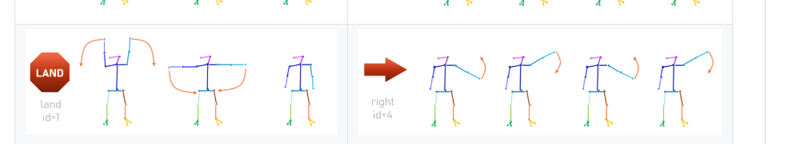
Gestures

Slide 9
Postures Large
STOP
start | 0
land | 1
left | 2
right | 3
move forward | 4
looping | 5
Images were snapshotted at 159%. Use support lines for snapshotting.

Slide 10

Project Evolution
Stage 1
PoseNet
Posture Calculation with Deltas
Movement Display
Video
Wireframe
Movements
Stage 2
PoseNet
Posture Detection with Keras Model
Movement Display
Video
Wireframe
Movements
Stage 3
PoseNet
Gesture Detection with Keras Model
Steering Module
Video
Wireframe
Movements
Stage 4
PoseNet
Gesture Detection with Keras Model
Steering Module
Video
Wireframe
Movements
New functionality for a stage
Accounting
Accounting System
Azure SQL
Pricing Parameters
Reference Data
Contract Data
Payment
eBanking
Container Provider System
Insurer Contract Management System
Delivery of transport data:
Client
Start / end position
Temperature data
Storage of contract data for risk and capital management purposes
Storage of claims data for claims settlement
Transport Data
Contract Data
Document Storage
Legend:
Manual Interface
REST API
System
Database
Report
Component
Functionality
Flow
Logic Apps
Azure Functions

Slide 11
Postures vs. Gestures
Posture
A posture is one single static position. It is thus possible to derive the movement from a single picture.
Modelling this is straight-forward. We train the model with single position data. Once trained, the model predicts a movement from a given position.
Move right
…turns into…
Model
Move right
Gesture
A gesture is a sequence of interconnected positions, e.g. a circle movement done with the hand. This allows for more complex movements.
…turns into…
Do 360° Spin
Compared to the posture model the gesture model now needs a group of positions including their sequence as input.
Model
Do 360° Spin
Gestures are also anchored in time. We assume a maximum duration of two seconds for a gesture. For each step of in time (0.05 sec) we thus send 40 positions covering the last two seconds.
40 positions = 2 sec
40 positions = 2 sec
40 positions = 2 sec
40 positions = 2 sec
t = 0.00 sec
t = 0.05 sec
t = 0.10 sec
t = 0.15 sec

Slide 12
Plan
Resolve open points:
Record a couple of test videos
Find a way how to get PoseNet working on Python with test videos
Transform PoseNet output into features / labels
Find a way how to steer the drone using Python
Find out how we can use live streams in a model
Plan:
Record videos to get train / test data
Generate features for PoseDetection model
Train PoseDetection model
Connect PoseNet, PoseDetection and steering module

Slide 13
Project Evolution
Stage 1
PoseNet
Posture Calculation with Deltas
Movement Display
Video
Wireframe
Movements
Stage 2
PoseNet
Posture Detection with Keras Model
Movement Display
Video
Wireframe
Movements
Stage 3
PoseNet
Posture Detection with Keras Model
Steering Module
Video
Wireframe
Movements
Stage 4
PoseNet
Gesture Detection with Keras Model
Steering Module
Video
Wireframe
Movements
Stage 5
PoseNet
Gesture Detection with Keras Model
Steering Module
Video
Wireframe
Movements
Accounting
Accounting System
Azure SQL
Pricing Parameters
Reference Data
Contract Data
Payment
eBanking
Container Provider System
Insurer Contract Management System
Delivery of transport data:
Client
Start / end position
Temperature data
Storage of contract data for risk and capital management purposes
Storage of claims data for claims settlement
Transport Data
Contract Data
Document Storage
Legend:
Manual Interface
REST API
System
Database
Report
Component
Functionality
Flow
Logic Apps
Azure Functions

